Slide 1


History of New Arthropod Detections in Florida
Norman C. Leppla, J. Howard Frank, Michael C. Thomas and Paul E. Skelley
International Congress of Entomology
Orlando, Florida - September 27, 2016

Slide 2

Queen Mary II and HMS Endeavour
James Cook’s first voyage of Exploration 1768 (~250 years)

Slide 3

Worldwide 8 million airline passengers per day
Airline flights per day- 102,465 worldwide (IATA, 2014)
Airline flights per year- 38 million worldwide
Passengers per year- 3 billion worldwide

Slide 4
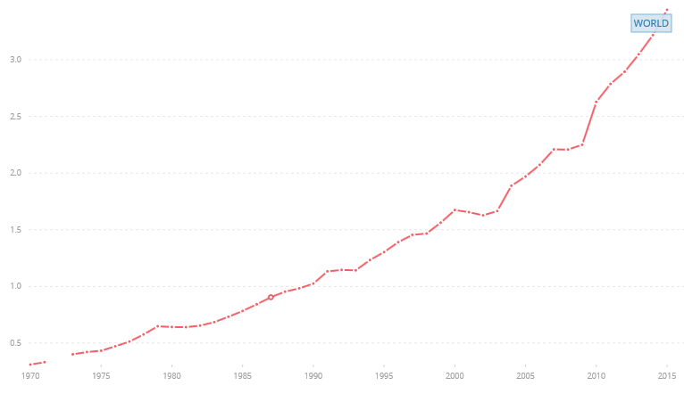
Rapid Increase in the Number of Airline Passengers
The World Bank
3.0
Number of Passengers (Billion)
1970
2015

Slide 5
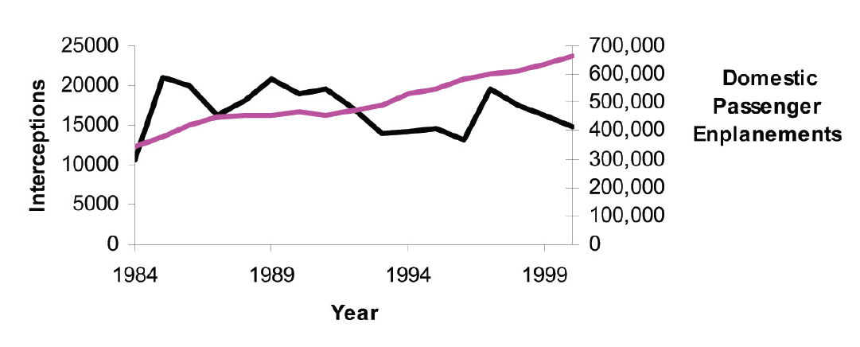
U.S. Insect Interceptions
and Passengers
Liebhold et al. 2006
Interceptions
Passengers

Slide 6
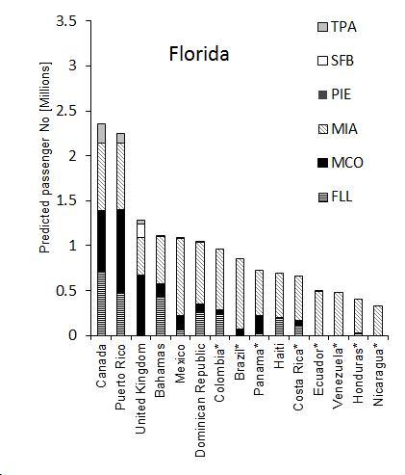
Florida
13.3 million international passengers
Arriving passengers (millions)
130 direct international flight origins (2010)
Szyniszewska et al. 2016

Slide 7
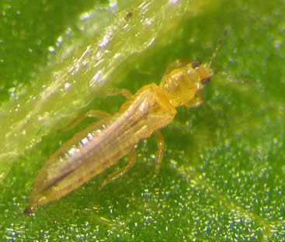
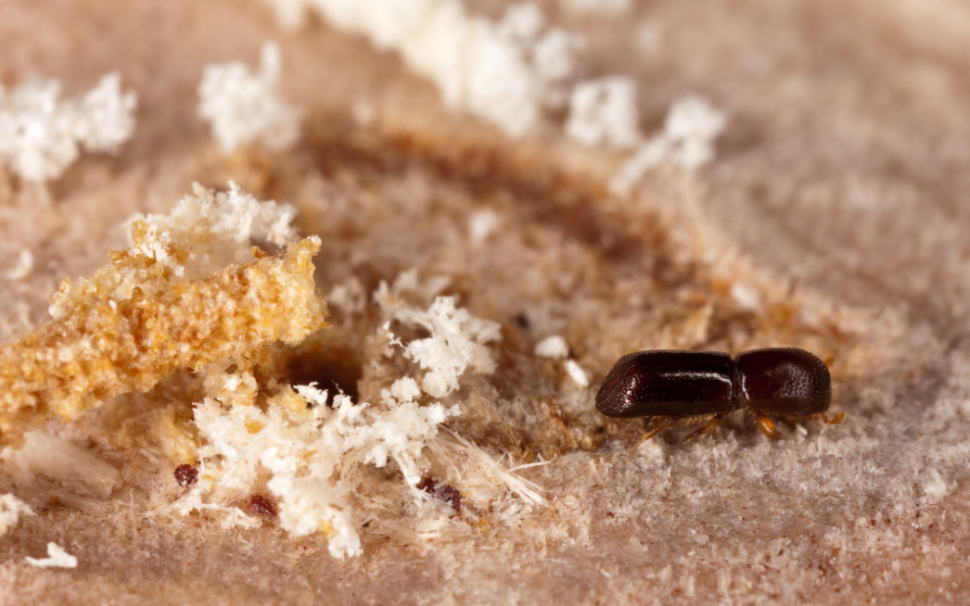
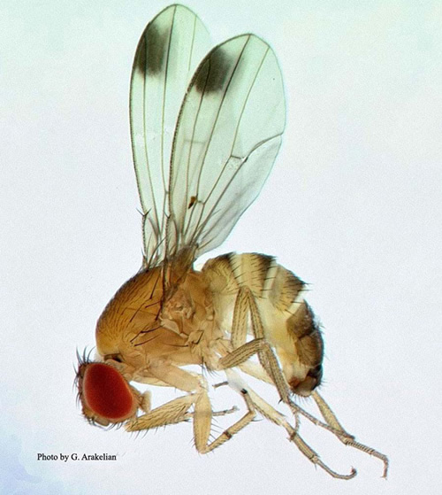
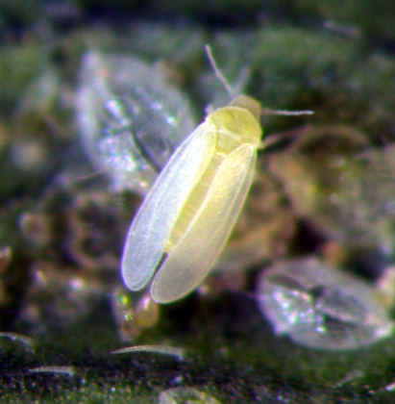
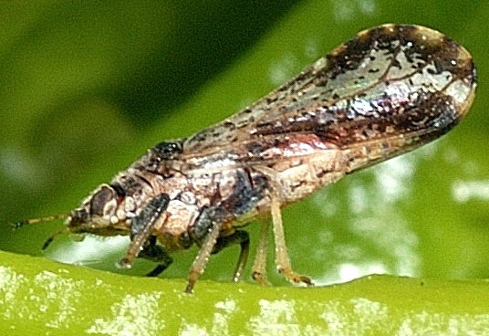
David Riley
Stephen Ausmus
David Hall
Lance Osborne
G. Arakelian

Slide 8
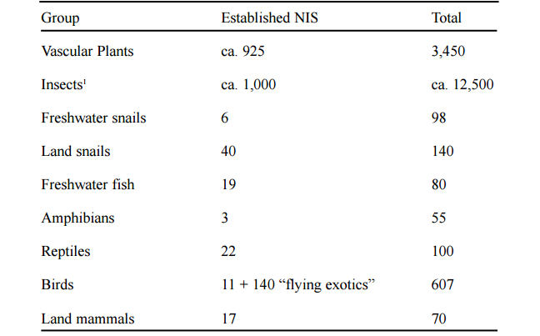
Estimated Numbers of Non-Indigenous Species in Florida
Klassen et al. 2002, Frank and McCoy, 1995a,b

Slide 9
Florida Insects
Species | Number | Percentage
Indigenous
Precinctive | 1,514 | 12.1
Indigenous not precinctive | 9,998 | 80.0
Total | 11,512 | 92.1
Adventive
Immigrant | 946 | 7.6
Introduced | 42 | 0.3
Total | 988 | 7.9
Total | 12,500 | 100
Precinctive= native and restricted to an area
Adventive= non-indigenous (Frank and McCoy 1995b)

Slide 10
Records 1970-1989 Frank, & McCoy 1992
Records 1990-2015 FDACS-DPI sample submission database

Slide 12
Records 1970-1989 Frank, & McCoy 1992
Records 1990-2015 FDACS-DPI sample submission database

Slide 14
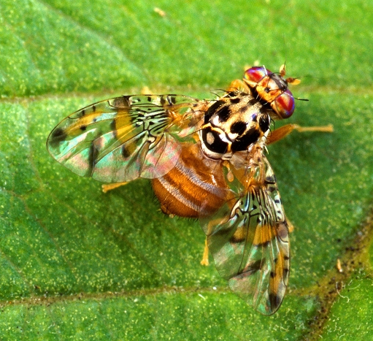
Medfly Interceptions at Florida Airports 2003-14
Country | Medflies
Spain | 76
Peru | 95
Nigeria | 26
Bolivia | 50
Ecuador | 45
Israel | 16
Romania | 31
Nicaragua | 26
Portugal | 23
Lebanon | 16
El Salvador | 11
France | 13
Venezuela | 15
Egypt | 13
Algeria | 2
Cameroon | 4
Total | 462
Scott Bauer, USDA, ARS, Bugwood.org
Szyniszewska et al. 2016

Slide 15
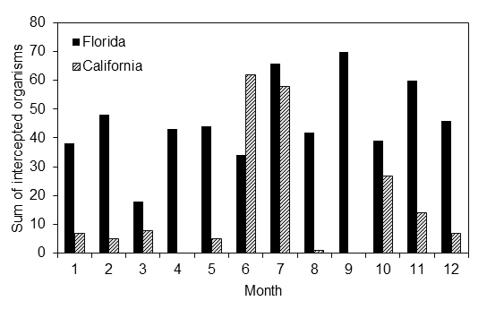
Medfly Interceptions in Florida
Cumulative number of living and dead medfly interceptions in
passenger luggage at Florida and California airports in 2003-2014
(PestID, Szyniszewska 2013)

Slide 16
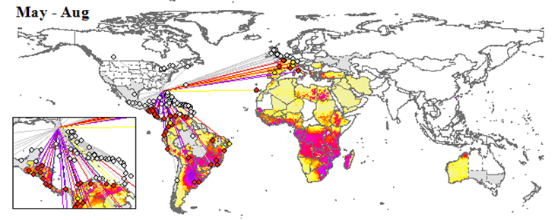
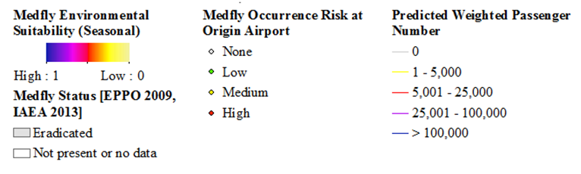
Medfly Invasion Pathways- Airports
Szyniszewska et al. 2016

Slide 17
Fruit and Vegetable Imports at Florida Seaports
Fruit and vegetable imports (tons) into Florida in 2004-2008
Medfly host status
No host
Occasional
Primary
Szyniszewska 2013

Slide 18
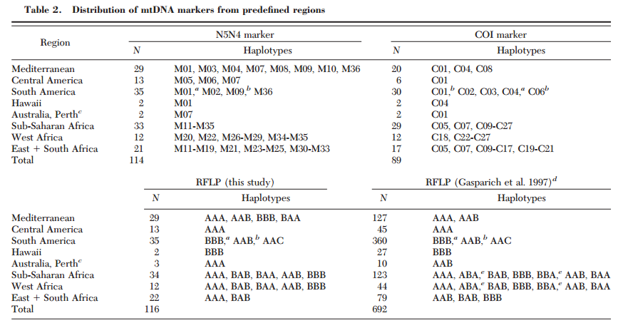
Medfly Genetic Analysis
Barr 2009

Slide 19
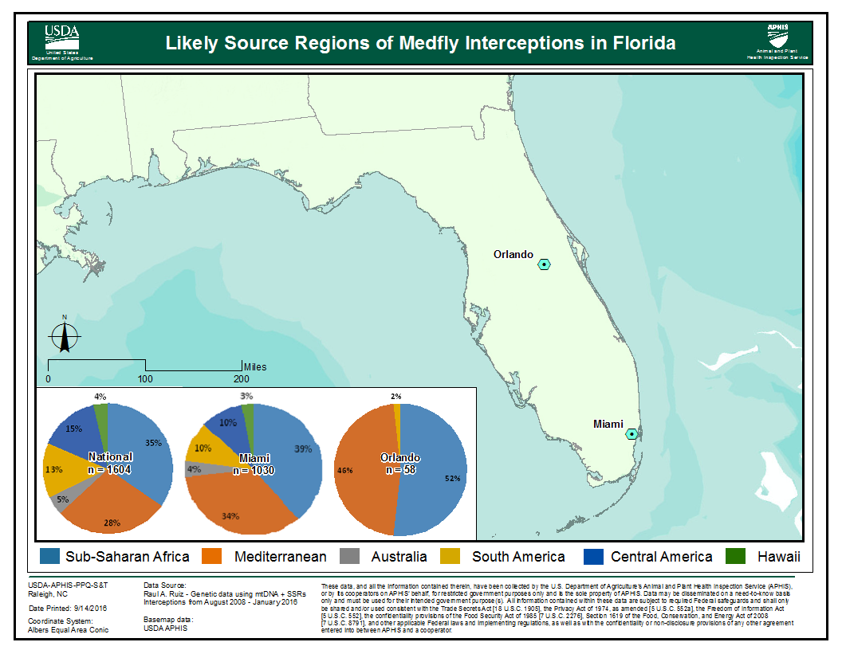
USDA-APHIS-PPQ-S&T
mtDNA & SSRS
Ruiz 2016, Hastings 2016

Slide 20
Fruit Fly Invasions in Florida
Year (erad.) | Intercepted | Species | Number flies | Number counties | Duration (months) | Cost
1929 (1) | Orlando | MFF | --- | 20 | 18 | $7.5 mil.
1956-72 (3) | Miami, St. Pete., Sarasota | MFF, OFF, CFF, Mex | 1-11,932 | 38 | 2-18 | $20,000- 11 million
1981-88 (3) | Miami, St. Pete., Tampa | MFF | 1-17 | 7 | 3-6 | $100,000-1.3 million
1990-98 (4) | Miami, St. Pete., Tampa, Orlando, Umatilla, Sebring | MFF, OFF | 1-1,315 | 15 | 3-11 | $100,000-4.7 million
1999-03 (2) | Miami, St. Pete., Tampa, Orlando, Homestead | MFF, OFF GFF, Mex | 1-16 | 14 | 3-7 | $100,000
2004-08 (0) | Miami, Orlando, Jacksonville | MFF, OFF, GFF, NFF | 1-2 | 9 | 3 | ---
2010-15 (3) | Miami, Tampa, Orlando | MFF, OFF, GFF, PFF | 1-159 | 8 | 3-6 | $801,000-3.5 million
2016 | St. Petersburg | OFF | 1 | 1 | --- | ---
16 Eradication campaigns Total $68.8 million
MFF- Mediterranean, OFF- Oriental, CFF- Caribbean, Mex- Mexican, GFF- Guava, NFF- Natal, PFF- peach (H. V. Weems, G. J. Steck)

Slide 21
Cost of Fruit Fly Invasions
The 2015 oriental fruit fly invasion in Miami-Dade County in 2015 cost $3.5 million for eradication but the total regional impact was estimated at $10.2 million (grower direct loss $4.1 million, government agencies spent $16 million, $19,506 per day!) (Alvarez et al. 2016)
The medfly invaded Florida first in 1929 and later in 1956, 1962, 1963, 1967, 1981, 1990, 1997, 1998, 2010 (Thomas et al. 2010), each time followed by eradication and continued surveillance and suppression. Eradication of a single outbreak in the Tampa Bay area in 1997 cost $25 million (Szyniszewska 2013)

Slide 22
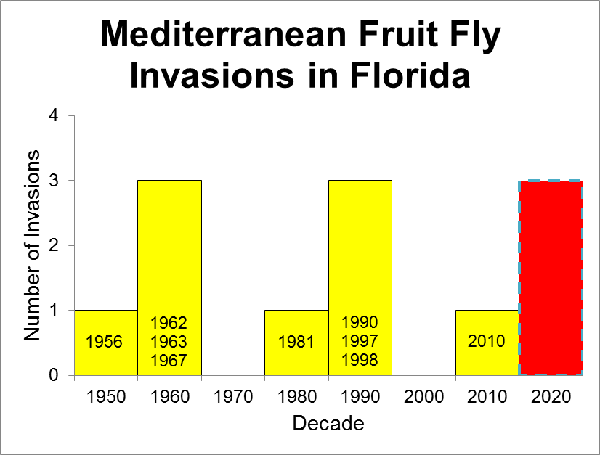
Thomas et al. 2010

Slide 23
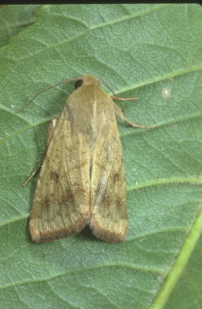
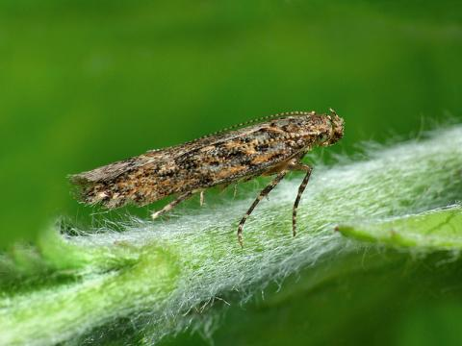
Current Situation
Over the past 30 years, new species have been added to Florida’s fauna at a rate of about one per month (Frank and McCoy 1992).
What will it take to stop
these invasions
?
Tuta absoluta
Old World Bollworm

